Slide 1

GIT
Trainer: Nikhil Shah

Slide 2

What is GIT
Git is a version control system.
Git helps you keep track of code changes.
Git is used to collaborate on code.

Slide 3
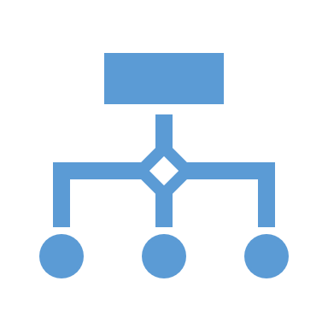
Git basics
Git is a free and open-source version control system, originally created by Linus Torvalds in 2005. Unlike older centralized version control systems such as SVN and CVS, Git is distributed: every developer has the full history of their code repository locally. This makes the initial clone of the repository slower, but subsequent operations such as commit, blame, diff, merge, and log dramatically faster.
Git also has excellent support for branching, merging, and rewriting repository history, which has led to many innovative and powerful workflows and tools. Pull requests are one such popular tool that allows teams to collaborate on Git branches and efficiently review each other's code. Git is the most widely used version control system in the world today and is considered the modern standard for software development.

Slide 4

How Git works Here is a basic overview of how Git works:
Create a "repository" (project) with a git hosting tool (like Bitbucket)
Copy (or clone) the repository to your local machine
Add a file to your local repo and "commit" (save) the changes
"Push" your changes to your main branch
Make a change to your file with a git hosting tool and commit
"Pull" the changes to your local machine
Create a "branch" (version), make a change, commit the change
Open a "pull request" (propose changes to the main branch)
"Merge" your branch to the main branch

Slide 5

Demo - Steps
Create a github account
https://github.com/
Download and Install git
https://git-scm.com/download/win
Create a new repository from browser
Clone the repository
Git clone url
Add new files and folder to cloned repository
Git commit –m “meaningful message ”
Git push

Slide 6
Steps
https://docs.github.com/en/get-started/start-your-journey/hello-world

